Slide 1

Capital Raise.

Slide 2
Opportunity.
Proof of Concept.
Palm has identified, connected, communicated and continuously met the needs of a well-established customer segment within the golf world.
Palm has proven to meet their needs year after year while introducing new products along the way.
Unlock the Potential.
The foundation has been poured, the sales channels have been primed and the product creation has been set.
Palm needs to inject some strategic investment to unlock the tremendous potential that lies ahead.

Slide 3
Industry Outlook.
Golf is growing.
The golfer is evolving.
The golf lifestyle is expanding.
Participation in the sport has seen double digit growth over the last 5 years with over 36 million players in the US. Largest Segment is 18–34-year-old male, with 6.2M participants in 2022.
Youth interest is on the rise, with 11% increase over the last 3 years. There were 3.4M Jr. Golfers in 2022.
Women are golfing more than ever before. Women’s golf apparel and accessories sales were up 16%, to $25.6M in 2022.
Digital Engagement – golf’s digital footprints is soaring with over 25% increase in online golf related content.
Golf consumers continue to transition from the mainstream brands to the newer golf specific brands
As golf grows, consumers demand more stylish and functional apparel and accessory options.

Slide 4
Palm is poised to win this Opportunity.
Golf is growing.
The golfer is evolving.
The golf lifestyle is expanding.
Participation in the sport has seen double digit growth over the last 5 years with over 36 million players in the US. Largest Segment is 18–34-year-old male, with 6.2M participants in 2022.
Youth interest is on the rise, with 11% increase over the last 3 years. There were 3.4M Jr. Golfers in 2022.
Women are golfing more than ever before. Women’s golf apparel and accessories sales were up 16%, to $25.6M in 2022.
Digital Engagement – golf’s digital footprints is soaring with over 25% increase in online golf related content.
Golf consumers continue to transition from the mainstream brands to the newer golf specific brands
Digital media and commerce are Palm’s primary lead generation and transaction source.
This is Palm’s primary customer.
Youth and Female represent new categories for Palm in 2025-26.
As golf grows, Palm will meet the consumer demand for stylish, functional, and comfortable apparel & accessories.

Slide 5
Who we are.

Slide 6
Our Story.
Palm Golf began with a few buddies and a standing weekly tee time at a local muni course in Orange County, CA. In between numerous three-putts and duffed chips, we talked about ideas and visions on how to improve the game of golf.
Since no one should trust us to teach the game of golf, we decided to find something we could improve-
the style.
We started with the often neglected, but vastly used product, the glove.
We have grown our products to provide apparel and accessories for both the clean-cut, tucked-in country clubber and the high-top, jogger-wearing, muni-hacker. Whatever your style or skill, Palm will bring style to your game. But most importantly to us, whether you birdie or double bogey, always #swingandsmile.
Our Mission.
To bring a smile to your game – on and off the course.
Our Values.
We have fun on and off the course.
We embrace all players.
We respect the game.
We are authentic and build quality products.
Like the sport, we are ever-evolving.

Slide 7
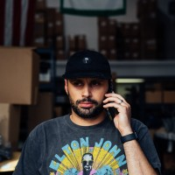
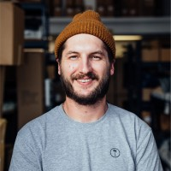
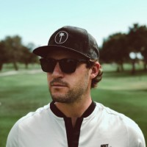
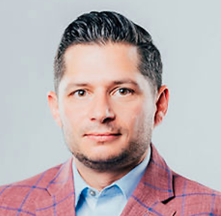
Our Team.
Palm’s team brings depth and breadth of cross-functional experience and in-vertical knowledge.
Joseph Ciafardoni
COO&CFO
Justin Junior
Chief Marketing Officer
Dustin Ghaul
Chief Production Officer
Craig Ungaro
Chief Strategy Officer
Prior to Palm, Joe managed capital markets and secondary marketing functions, including pricing, trading, hedging and secondary market execution. After serving a leadership role for several years Joe was recruited to share expertise with an industry trade group serving 100+ companies that totaled over $75 billion per year in origination activity.
At Palm, Joe facilitates the coordination between Production, Marketing, Operations, and Finance. Joe also serves as front line support to our wholesale partners including all major retail partners, green grass accounts and corporate accounts.
Justin is a career entrepreneur and has the benefit of working in some successful start-ups along the way. Prior to Palm he managed graphic design at both Travis Mathew and Haus of Grey.
As founder of Palm, he is responsible for all things digital. He’s built and managed a digital marketing department overseeing $400k in annual advertising with over $1MM in annual sales. Built Palm’s owned media resulting in over $750k in annual sales with over 50% YOY growth.
Justin leads the creative design direction for digital marketing campaigns and product design. He is also responsible for building and managing the e-commerce architecture along with 3rd party software implementation.
Dustin has over 9 years of dedicated experience in product development, design, and planning. His commitment to quality and innovation, has been instrumental in establishing Palm as a premium brand for the modern golfer. His expertise in sourcing, production planning, and supply chain management have played a key role in meeting the market demand. Dustin’s passion for the game and his expertise in the production development make him an asset to the company’s mission of revolutionizing the golf industry.
Dustin has a Masters in Education and teaches graphic design in addition to his responsibilities at Palm
Craig has over 10 years of Executive Leadership experience. Palm is Craig’s 3rd start-up. Craig’s successfully scaled a financial services organization from being employee #3 to over 1000 employees, serving all 50 states with over $6B per year in origination activity. Craig has served as a Palm advisor since 2019. Since formally joining the organization in 2021, Palm has scaled 300% in revenue in less than two years and looks forward to multiples of that success in the next few years.
In addition to serving as primary advisor to Palm’s founders, Craig’s involvement includes financial management and serves lead on all professional services core to Palm’s business administration (i.e. legal, accounting, etc). Craig also negotiates and manages all marketing affiliation arrangements and key business relationships.

Slide 8
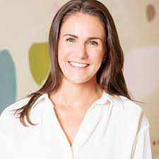

Key Advisors.
Our advisors bring deep industry knowledge and experience that complements the Palm team. Their partnership expands our overall leadership capability.
Ellen Duncan
Marketing & Growth
Mimi Disipio
Retail Strategy & Merchandising
Ellen Duncan is a global marketing transformation leader. With Accenture, she led the digitization of the in-flight experience with Southwest Airlines and the mobile shopping journey for General Motors. Ellen then spent eight years with The Coca-Cola Company as the driving force in the digitization of consumer marketing across the globe.
Since 2020, Ellen is the Owner and Principal Lead of Pineapple Partners, a growth marketing consulting firm. The firm partners with clients across industries to deliver strategic projects, lead long-range planning, and develop holistic marketing plans. Ellen individually partners as a Fractional CMO for a few key clients.
Mimi has over a decade of experience in a range of operational and advisory roles within the Apparel and Footwear industries. She spent five years in Global Merchandising and Production at Abercrombie and Fitch where she led end-to-end assortment strategy and product development for the Women's and Kids brands before moving to Under Armour. At UA, she led Global Category Management for Youth apparel and footwear, including owned and wholesale expansions in the US and EU. She has since leveraged her experience in assortment planning, production management, and go-to-market strategy as a strategic advisor to several global fashion retailers as a member of Boston Consulting Group's Fashion and Luxury practice. Her expertise is in consumer-centric assortment strategy and data-driven decision making. Mimi has a Bachelor's degree from the University of Notre Dame and an MBA from Harvard Business School. She currently lives in London where she is Transformation Director for Kantar, a private-equity owned consumer research and technology company.

Slide 9
The business today.

Slide 10
Business Performance:
Strong Paid Media Conversion
3.07%
Direct Communications driving significant revenue
$800,000
in revenue attributed to email/SMS automated marketing journeys
Growing and actionable first-party database
134,000
85% active

Slide 11
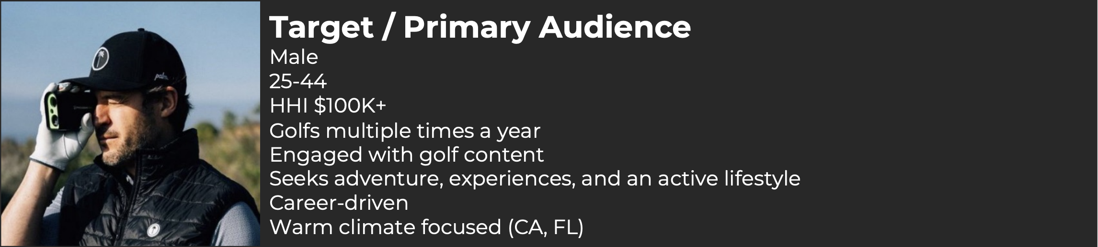
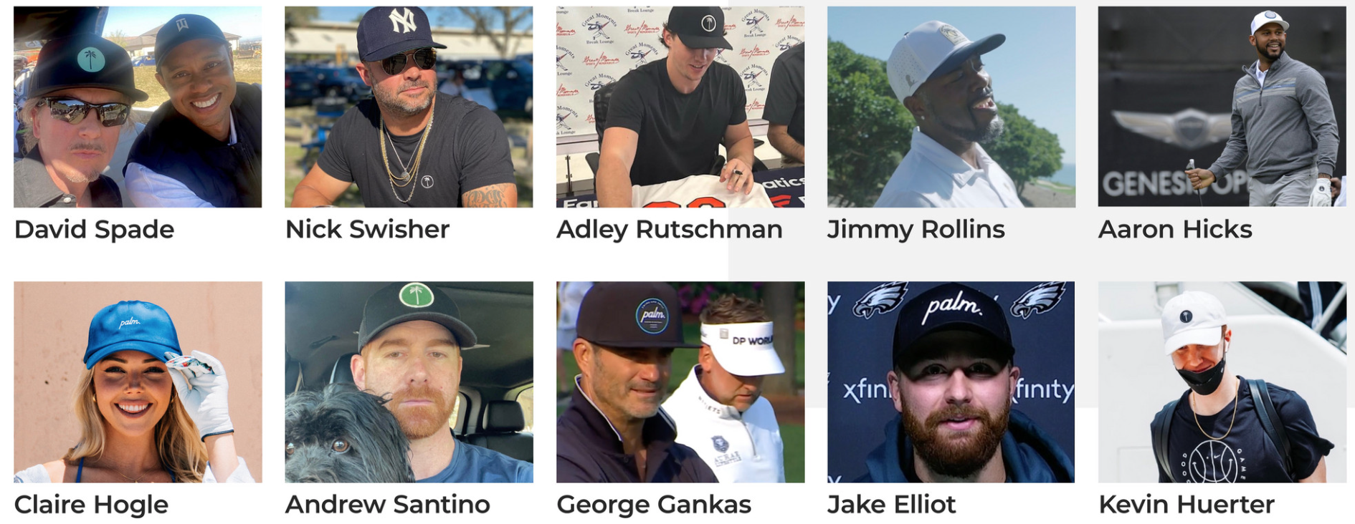
We’re gaining awareness with target audience.
And gaining relevance via key category influencers.

Slide 12
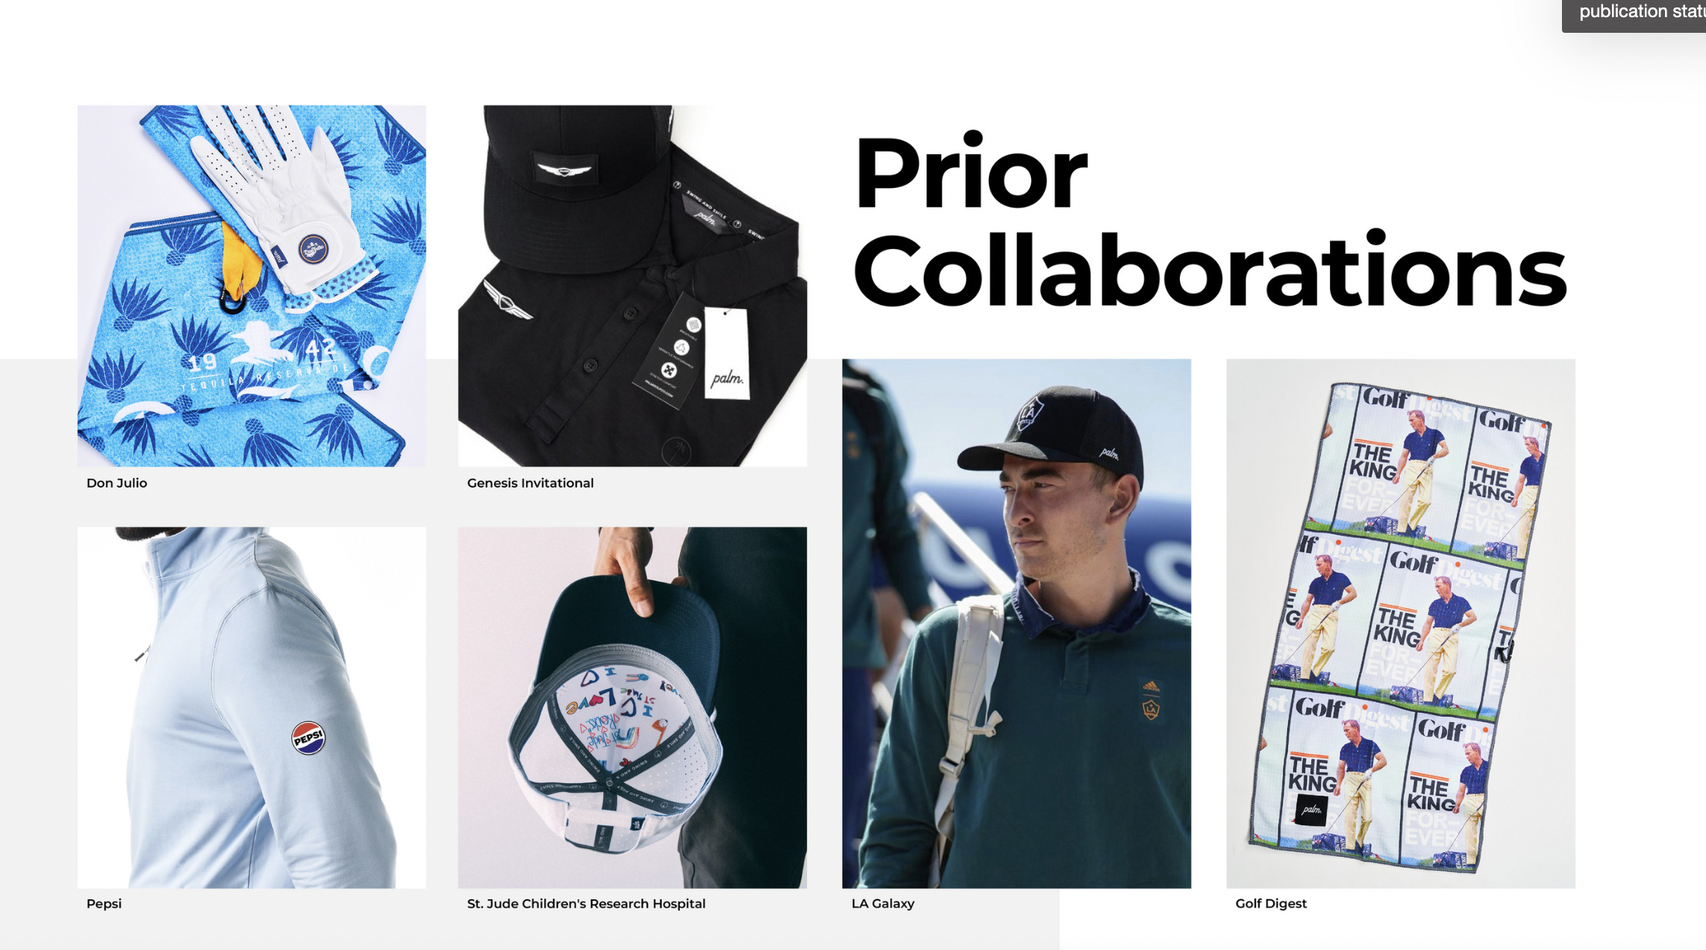

Slide 13

























The earned media is growing.
Our roster of partner brands underscores the relevance Palm carries with our consumers, partners, and within the industry.

Slide 14
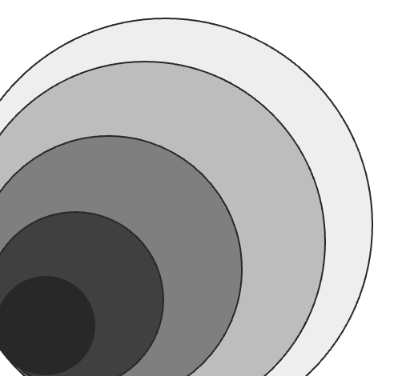
Women’s apparel
Our Product Journey.
Men’s lifestyle apparel
Palm enables the lifestyle of golf. Our apparel and accessories are rooted in the game of golf but are worn by lovers of fun on and off the course.
On course
Off
Lifestyle
Men’s golf apparel
Accessories
Youth
Headwear
Women’s glove
The Glove
Towels
2018-20
2021-22
2023-24
2025-28

Slide 15



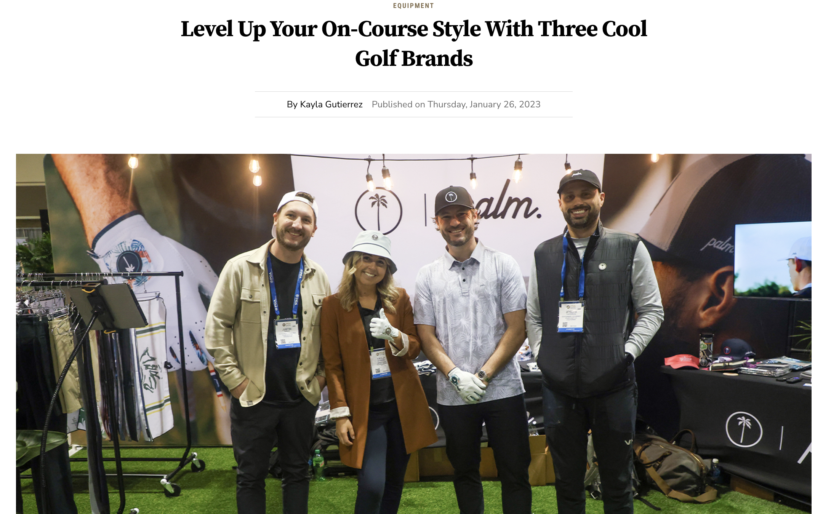

Product Validation: The industry is recognizing us.
Catching the golf worlds attention: "Featured product as Favorite Things from the 2020 and 2023 PGA Show" – Golf Channel.
Golf Digest Collab with some of Golf’s Coolest Brands.
“Best lifestyle glove 2018, 2019, 2025”
- MYGOLFSPY

Slide 16
The business tomorrow.

Slide 17
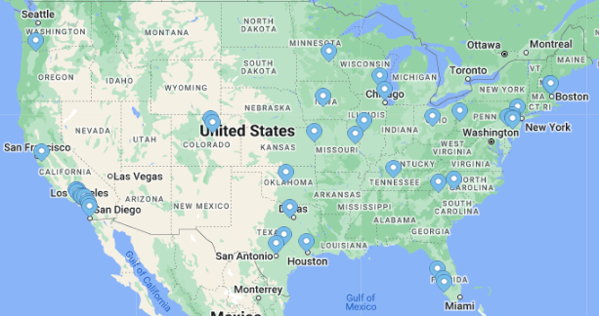
Go to Market Strategy.
Today, we sell nationwide and most of our business is direct vis our website.
2026+ we will continue to expand across retail channels.
Retail Channel | Revenue % in 2024 | As of 5/30/25
DTC eComm | 72% | 53%
Wholesale | 18% | 37%
Amazon | 9% | 9%
Other/Mobile Retail | 1% | 1%
Opportunity to scale and further diversify
Breadth of geographic footprint, with opportunity to penetrate deeper outside of SoCal.

Slide 18
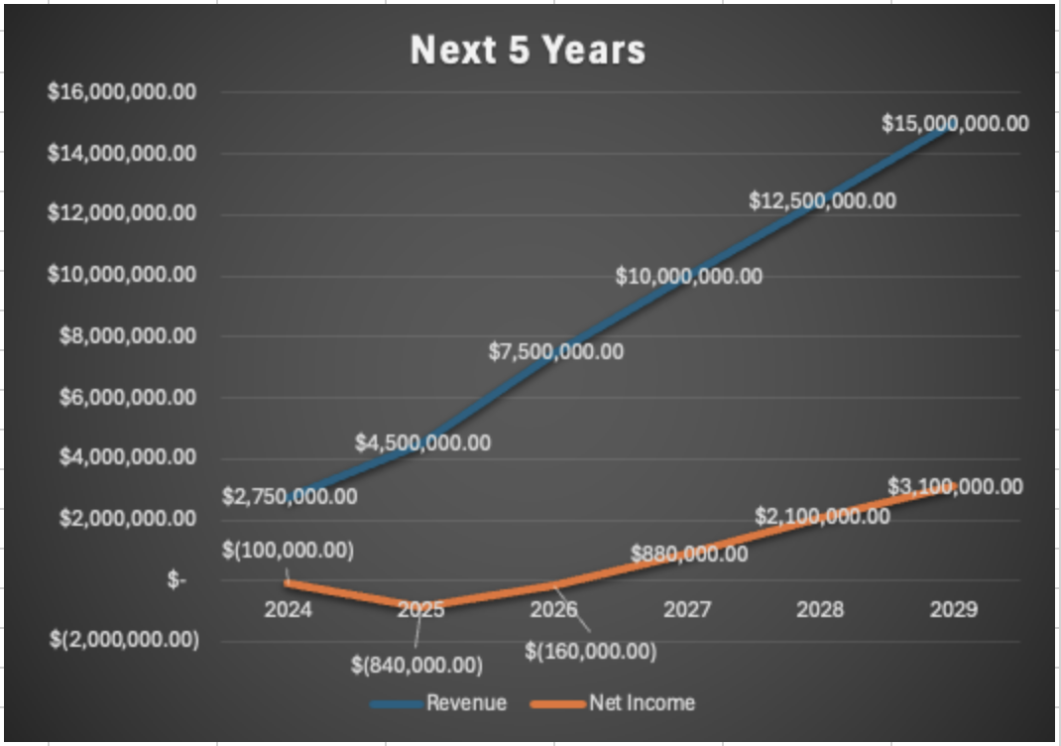
Growth Forecast.
The known entity:
Palm’s customer acquisition trajectory along with a 38%+ returning customer rate puts Palm on a path for a
$4.5M+ 2026.
The new levers:
Scaled Paid Media
Palm’s yet to do any mass marketing and plans to invest in these efforts making 2026 the biggest customer acquisition year to date.
New Brand Partnerships
Palm is engaging with several established brands to collaborate additional product categories which is expected to accelerate customer acquisition and revenue growth.
Wholesale Investment
Through strategic hiring and past prospecting, Wholesale is expecting to surpass DTC efforts by year 2027 when both channels will eclipse $9MM.

Slide 19
The Financials.
No FTE’s
Wholesale Lesson
DTC lift
Added owners in payroll
Additional setup costs
Increased marketing spend
Expense Management Correction
Rolled back Marketing spend
Cap Raise preparation
 | 2022 | 2023 | 2024 | 2025 as of May 30,2025 | 2026
Revenue | $1,696,018 | $2,332,302 | $2,476,293 | $1,054,881.09 | $4,500,000
Gross Profit | $779,855 | $1,177,244 | $1,279,185.66 | $524,479.00 | $2,475,000
Total Expenses %Marketing | $807,849 57% | $1,699,886 51% | $1,533,458.22 62% | $523,543.51 60% | $3,275,000 65%
Net Income | ($27,994) | ($524,585) | ($236,521.69) | $2,471.55 | ($840,000)
Bootstrapped investment
Seed Round funding
Established infrastructure to scale DTC and wholesale
SEM and Test into Programmatic Media
Organic PR an Initial Influencer Reach
Scale omnichannel marketing
Added SME leads + Advisors
Website Optimization + Loyalty Program
Optimized Sourcing and Printing
Innovative licensing partnerships

Slide 20
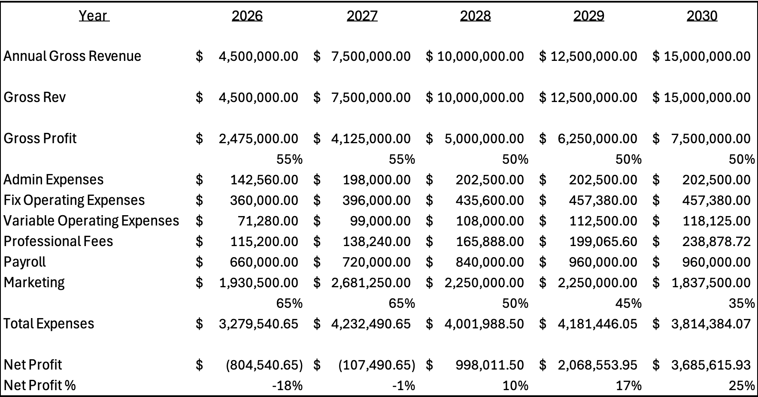
The Financials – Full Horizon.
What is this years Mkting exp allocation
GP should be steeper with Wholesale?
Branding Push & Wholesale Growth
Category Expansion & Operational Synergies
Broader Marketing Strategies (podcasts, event activations)
Tour endorsement opportunities
Cross over athlete, macro-influencers
Merchandising licensing opportunities
Complimentary Brand Collaboration
Wholesale Growth – invest in established relationships
Deeper reach into Women & Youth categories
Expansion in more off-course line
Equipment investments
Optimize warehousing/logistics/etc

Slide 21
Capital Raise.
To strategically recognize our growth opportunity, we must invest accordingly. This seed round will enable Palm to scale marketing while brand relevance is growing, engage the necessary talent, and ensure proper inventory availability.
Equity
$1.5MM raise on a $6MM Valuation.
Paid out over three six-month periods
25% Equity Position
Founders – 60%, Investors 40%.
Board Seat
Executive level voting rights*
Quarterly performance reviews
Categories | Allocation
Strategic Key Hires | $400,000
Marketing | $700,000
Optimizations | $400,000
Note: $1M in losses over year 2025 & 2026, $200k-$500k in asset acquisitions, equipment, licensing, inventory, etc
Palm currently has a $500k line for production costs with a commitment to $1M from minority owner

Slide 22
Capital Allocation Detail.
Until now, Palm is run by one full-time and two part-time founders along with a full-time photographer and Warehouse associate. Palm recognizes the need to add resources in key areas while refocusing the founders’ energy toward strategic growth. Some of the areas of need is within product design, social media, operations, and most importantly a Sales team. The new team members will have a proven track record of growing revenue with emerging and mainstream brands across multiple industries and product types. New additions will be primarily focused on Wholesale growth, both will play a major role in contributing to end-to-end product lifecycle management, assortment planning, seasonal launches and transitions.
Strategic Hires
Palm’s existing growth has come primarily from Paid Search and Social. Our growing email database continues to serve as a large portion of revenue, 2024 estimate $1M but both sources can be optimized with complimentary forms of media marketing. Palm has served over 80k customers to date but to more effectively reach the 6.2 million 18-34 male golfer, Palm plans to expand marketing efforts to the following channels: OTT, Audio, PPC/SEM, Direct Mail, and Print. Lastly, Palm has an opportunity to expand its Experimental efforts through existing relationships with credible partners like: St. Jude, Sierra Co, SCGA, Anaheim Ducks, Pepsi, Gensis, Reef, PGA and more!
Omnichannel Marketing/Branding
Operational Optimizations
There are key operational areas that need dedicated resource and focus. These include website optimization, IP protection, bigger warehouse, on-premise screen printing, mobile shop, loyalty program and more.

Slide 23
Strategic Hires
Day 1-90: Operational Buildout
Creative Support: Graphic Designer, Editor
Marketing: Social Media Manager, SMS & Email Marketing
Product Development: Line Planner, Tech Designer
Other: Web Developer, Warehouse Associate
Day 90-120: Wholesale sales leader + small inside sales team
Commissions will be factored in the Wholesale Gross Profit calculation
Need to front 6-9 months of salaries to build pipeline and realize revenue above current levels
Wholesale Leader - $75k-$100k base + 2-5% commission
Inside Sales team 3-4, $30k-40k base + 5-15% commission
$15k-$18k per month fixed expense to generate
Year 2: Full-Time CMO
- Timeline is estimate, triggering event is financial performance based.
Year 2-3: Full-Time Production Manager
- Timeline is estimate, triggering event is financial performance based.
Note: All Expenses are accounted for in proforma.

Slide 24
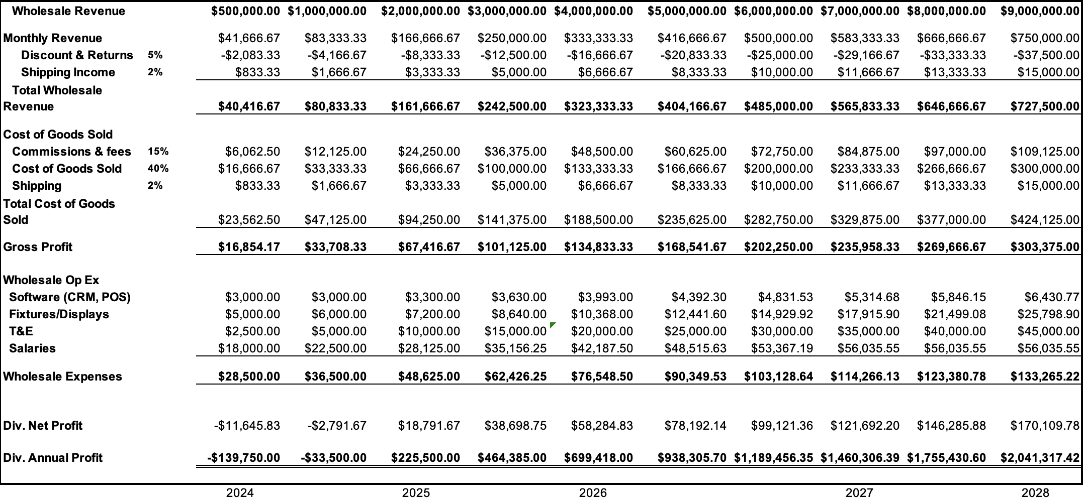
Strategic Hires & Wholesale Build Out
With fractional focus, Palm will exceed $500k in 2024 in wholesale business.
Palm is serving 32 green grass golf courses, 8 Retailers and 6 other types of brick and mortar.
Green Grass – 22 of 32 are in California.
Major Retailers include Sierra, World Wide Golf, TJMAXX, Sierra Company, Dicks Sporting Goods, Golf Galaxy
Other Types include Drive Shack, MullyBox, Gimme Golf Studio.
This doesn’t include partnerships like the following: Anaheim Ducks, Philadelphia Eagles, Genesis, Pepsi, LA Galaxy, etc.

Slide 25
Omni-Channel Marketing - Branding
Why:
Improve Advertising performance
Assist with Wholesale sales
Protect Palm tree mark
Reduce new customer acquisition costs
Build earned media
Approach:
Omni channel Marketing
Podcast advertising
OTT
Direct Mail
Email aka 1st party or earned media (ongoing)
Performance – 15 to 1 ROAS – build earned media
Direct aka Branded Search (ongoing)
Performance – 9 to 1 ROAS – can only scale via branding
Ambassador – i.e. tour players
Event activations
Physical Pop-Up Store (see equipment)

Slide 26
Licensing
Examples:
Brand Collaboration – Malbon & everyone, Lululemon and Bauer, TM and Bauer, TM and High Noon. Palm and Reef.
Major Sports Organizations - NCAA, NFL, MLB, NHL
PGA Events – Waste Management, Genesis, Pebble Beach Pro-Am, Farmers Open, American Century Classic.
Why:
- Brand Collaboration provides product diversification opportunity (i.e. Womens, Kids, footwear) without experimenting.
- Brand Collaboration also provides direct access to an expanded customer base with a trusted partner in the eyes of the consumer.
Sports Organizations – allows for a regional targeted play (i.e. SEC Campus collection) during slow season.
Sports Organizations – introduce Palm into specific markets through licensing effort
PGA Events – align to high-energy fun events and/or local ones to Palm.

Slide 27
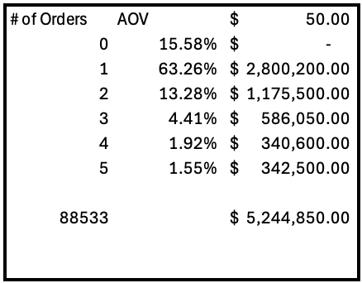
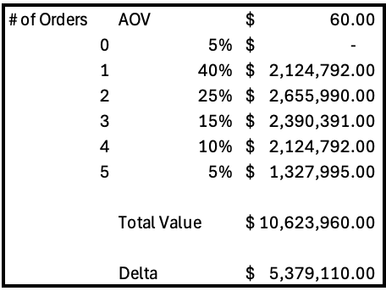
Operational Optimization
Loyalty Program & Website Optimization
While customer acquisition is critical to scalability, customer retention and increased AOV is the ripest opportunity for Palm in the short term. Of the 89k unique Palm less than 2% have done 5 or more orders. Below is a ‘From-To’ chart showing the expected output of a strong loyalty program which would be launched in 2025.
FROM
TO

Slide 28
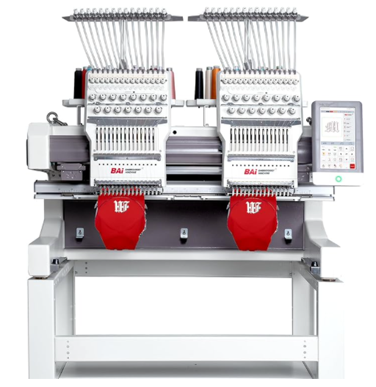
Equipment
Warehouse
Palm is in it’s second warehouse and had to add some additional storage on the same property in 2023. Lease expires in April 2026 and at capacity. Consolidating spaces and expanding for future growth will be part of 2026 plan.
Current space is approximately 2000 sqft, new space will be around 7000-10,000k sqft along with warehouse equipment.
Embroidery Machine(s)
Opportunity for Palm to turn orders around quickly in the wholesale space.
Provide limited drops based on current events or trends.
Quick replenishments based on fast selling items. Order blanks in bulk and only reprint fast selling designs, sizes, rather than guessing which one will do best.

Slide 29
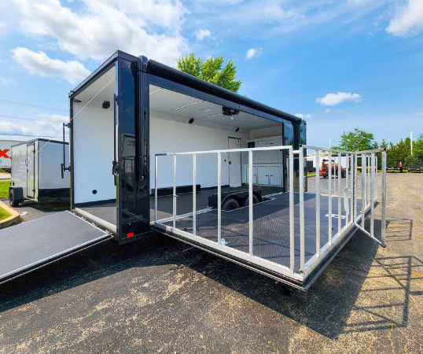
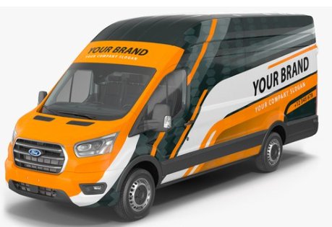
Equipment
Pop-up Palm Shop
There are 30-40 in-person opportunities within driving distance every year for us to provide presence. Annual opportunity is between $150k-$200k per year in retail revenue within first 2 years.
Roughly $100k investment which will be recouped within first 18 months in gross profit not including branding value. See Retail plan for specifics.

Slide 30
Next steps.
Additional Information by request
Meeting with stakeholders
Decision point 11/30 (estimate).

Slide 31
Thank you.
Notes:
Burke

